Slide 1
Activating portfolios of a CZ electronic collection from an Excel file when the portfolios do not have an ISBN or ISSN
Yoel Kortick. Senior Librarian

Slide 2



Introduction
Excel file from the vendor
Activating the portfolios from the Excel sheet
Fixing the Excel sheet so all portfolios will be activated

Slide 3
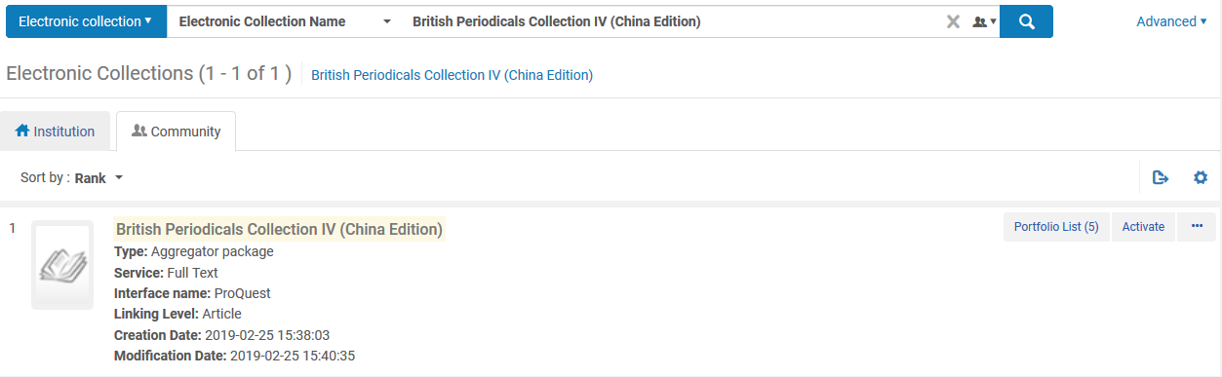
Introduction
In the example here we will activate the following collection from the CZ: "British Periodicals Collection IV (China Edition)"

Slide 4
Introduction
This collection has 5 portfolios, 3 of which have neither ISBN nor ISSN in the CZ record
Title “Humorist (via EBSCO Host)”. This does not have an ISBN or an ISSN
Title “ The Field”. This has an ISSN
Title “Wide World Magazine 22 [electronic resource]”. This has an ISBN
Title “Top Spot”. This does not have an ISBN or an ISSN
Title “Picture Show; London”. This does not have an ISBN or an ISSN

Slide 5
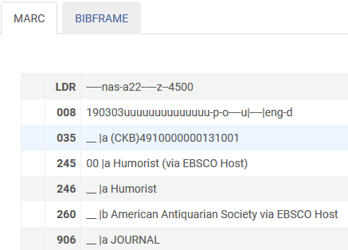
Introduction
For example here is title “Humorist (via EBSCO Host)”.
No 020 and no 022

Slide 6
Excel file from the vendor

Slide 7
Excel file from the vendor
The institution purchases the electronic collection and the vendor sends the institution an Excel file of the portfolios which have been purchased.
The Excel file contains bibliographic and inventory-related information.

Slide 8
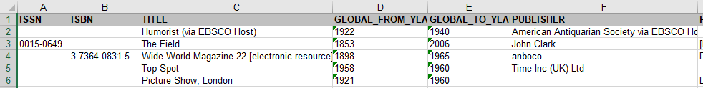
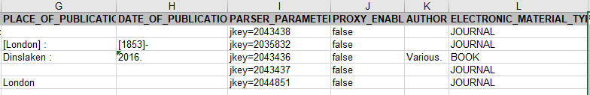
Excel file from the vendor
For example here is the Excel
No ISSN or ISBN

Slide 9
Activating the portfolios from the Excel sheet

Slide 10
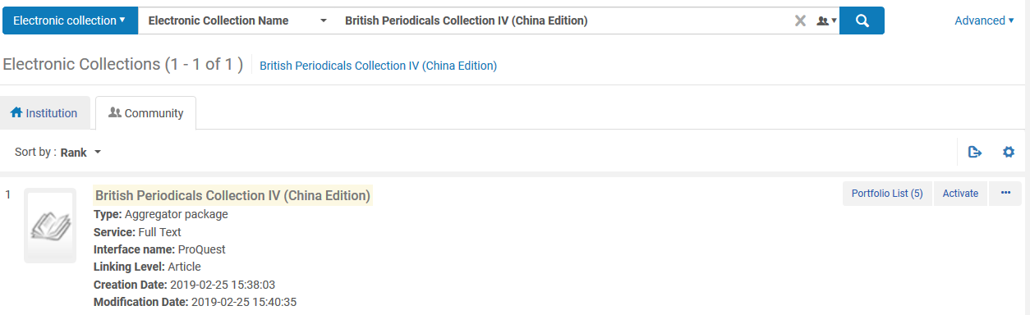
Activating the portfolios from the Excel sheet
From CZ electronic collection search we click “Activate” to open the activation wizard.
Note that in this presentation we are focusing specifically on the upload of an Excel without ISBNs / ISSNs. For a full explanation of the activation wizard see Activating an Electronic Collection Using the Activation Wizard

Slide 11
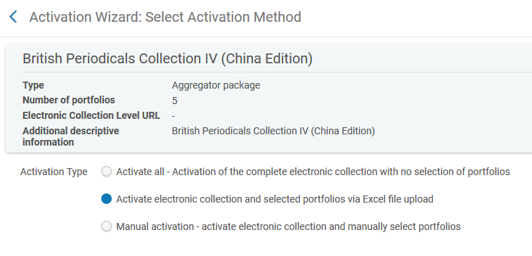
Activating the portfolios from the Excel sheet
On the third page of the activation wizard we will choose “Activate electronic collection and selected portfolios via Excel file upload”

Slide 12
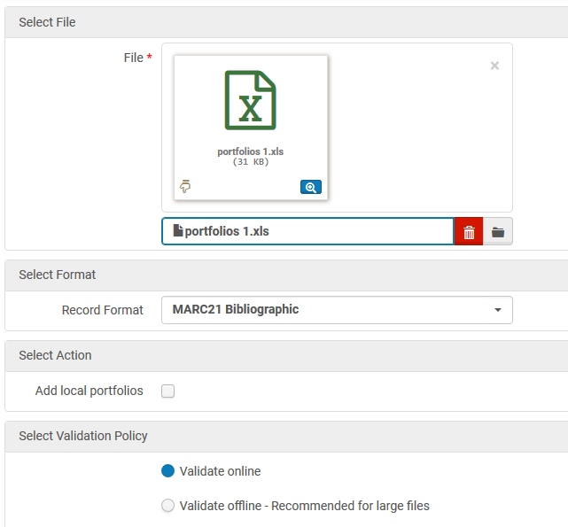
Activating the portfolios from the Excel sheet
Now we will upload the Excel sheet with option “validate online”

Slide 13
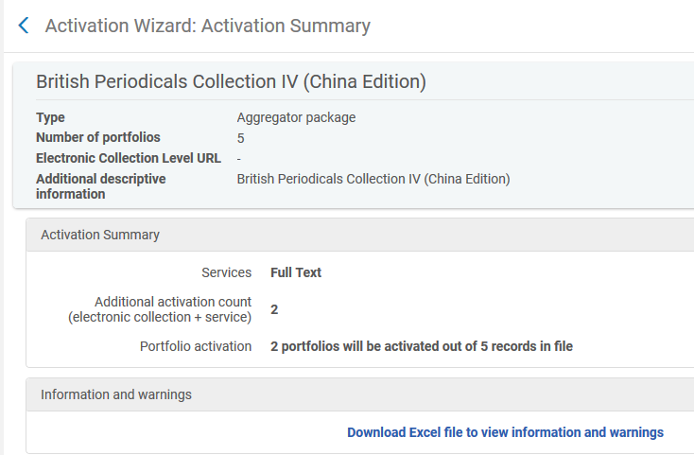
Activating the portfolios from the Excel sheet
Get message that only 2 of the 5 records will be activated
Let’s download the “information and warnings” file
2 of the 5 records will be activated

Slide 14
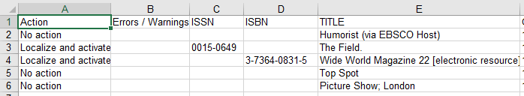
Activating the portfolios from the Excel sheet
We can clearly see that for the 3 records which have neither an ISBN or an ISSN no activation occurred.

Slide 15
Fixing the Excel sheet so all portfolios will be activated

Slide 16
Fixing the Excel sheet so all portfolios will be activated
It is possible to match the portfolios in the Excel sheet to portfolios in the electronic collection of the community zone via additional fields and not only by the ISBN / ISSN.
See Portfolio Loader. It is also possible to match by:
  OTHER_SYSTEM_NUMBER
  PORTFOLIO_PID
We will use the portfolio PID

Slide 17
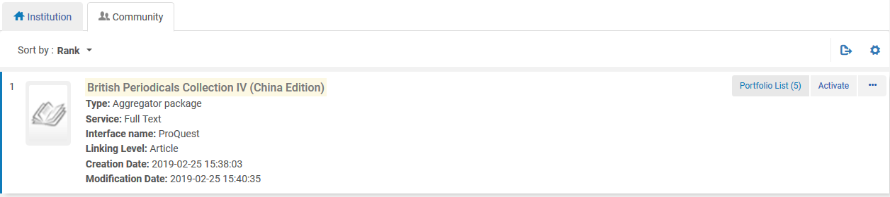
Fixing the Excel sheet so all portfolios will be activated
To get the portfolio ID export the portfolios to Excel from the portfolio list from the CZ.

Slide 18
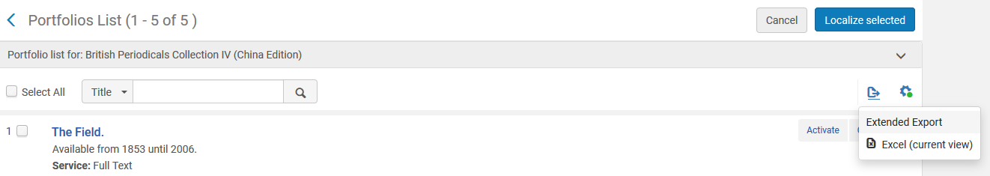
Fixing the Excel sheet so all portfolios will be activated
Export the “Extended Report”

Slide 19
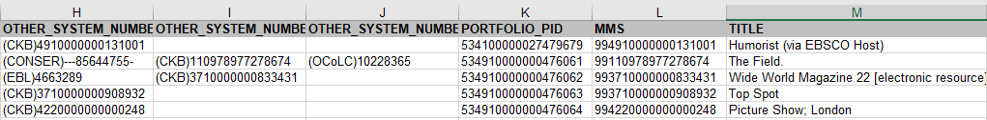
Fixing the Excel sheet so all portfolios will be activated
The PORTFOLIO_PID (and many other fields) are included in the report.

Slide 20
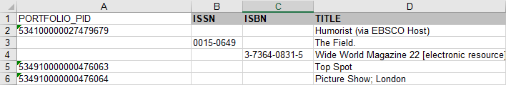
Fixing the Excel sheet so all portfolios will be activated
Now add the corresponding PORTFOLIO_PID to the Excel sheet received from the vendor for portfolios which do not have an ISSN or ISBN

Slide 21
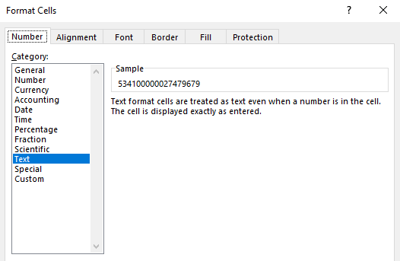
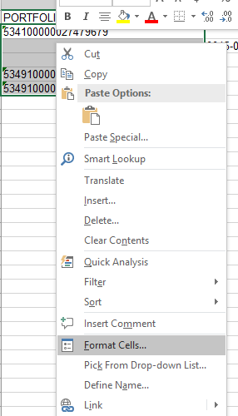
Fixing the Excel sheet so all portfolios will be activated
Make sure that when you add the PORTFOLIO_PID to the Excel sheet which you received from the vendor the cells are defined as format text

Slide 22
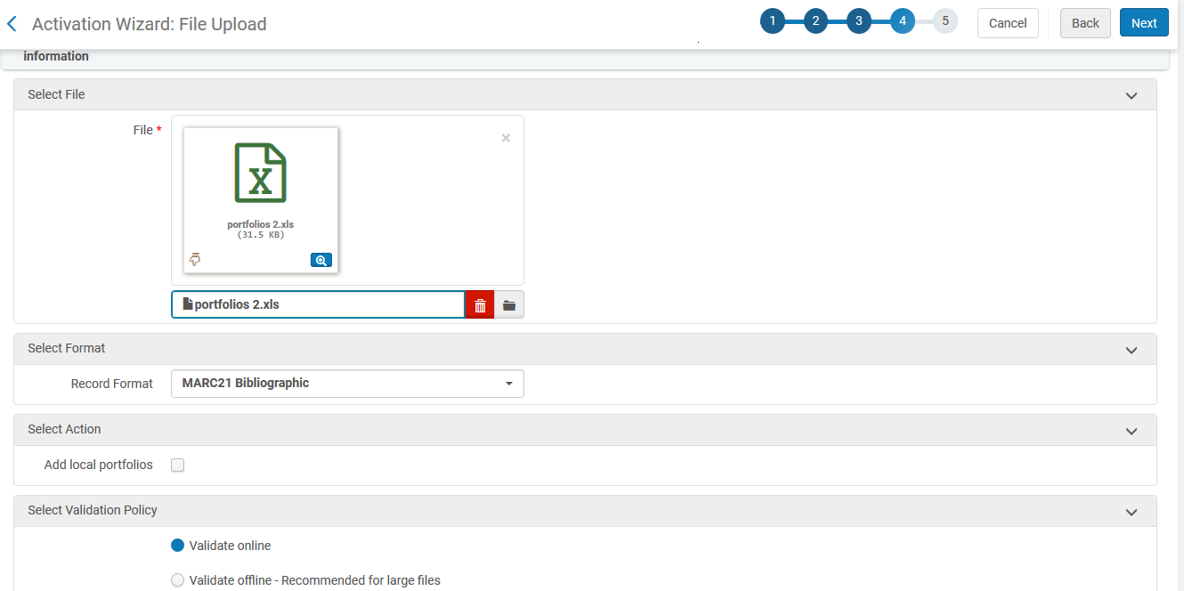
Fixing the Excel sheet so all portfolios will be activated
Via the activation wizard upload the fixed Excel sheet

Slide 23
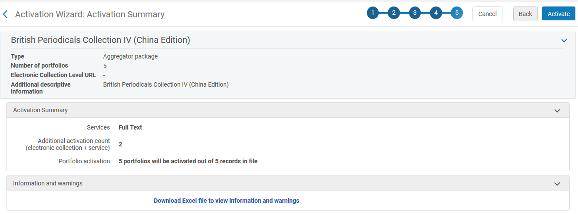
Fixing the Excel sheet so all portfolios will be activated
Now all 5 portfolios will be activated (which means a match was found)

Slide 24
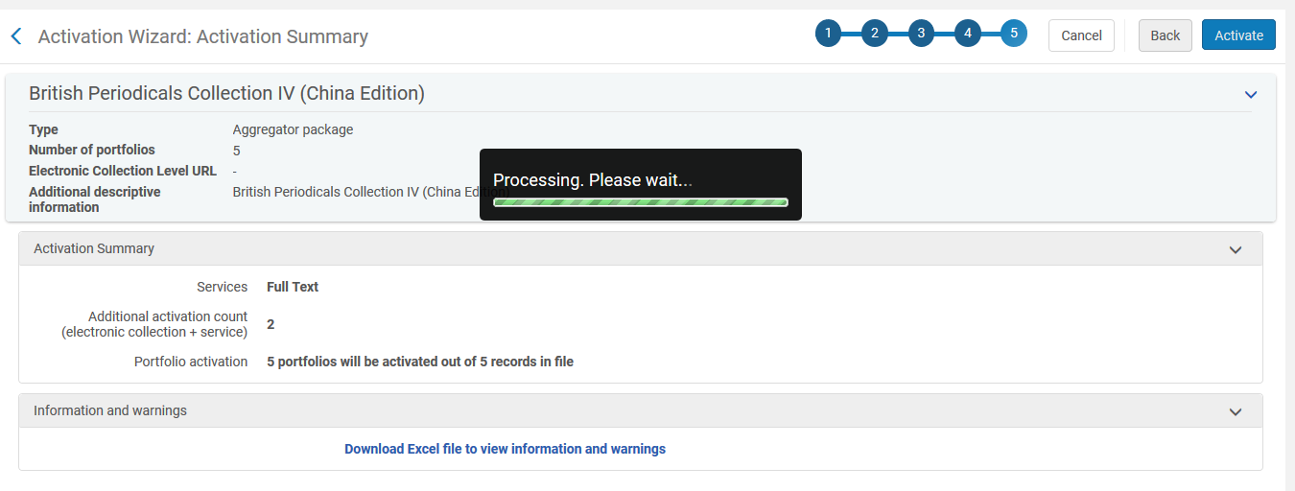
Fixing the Excel sheet so all portfolios will be activated
Now we will click activate

Slide 25
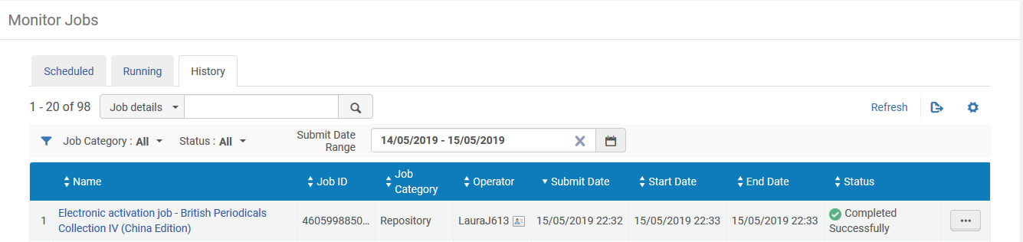
Fixing the Excel sheet so all portfolios will be activated
The activation job runs

Slide 26
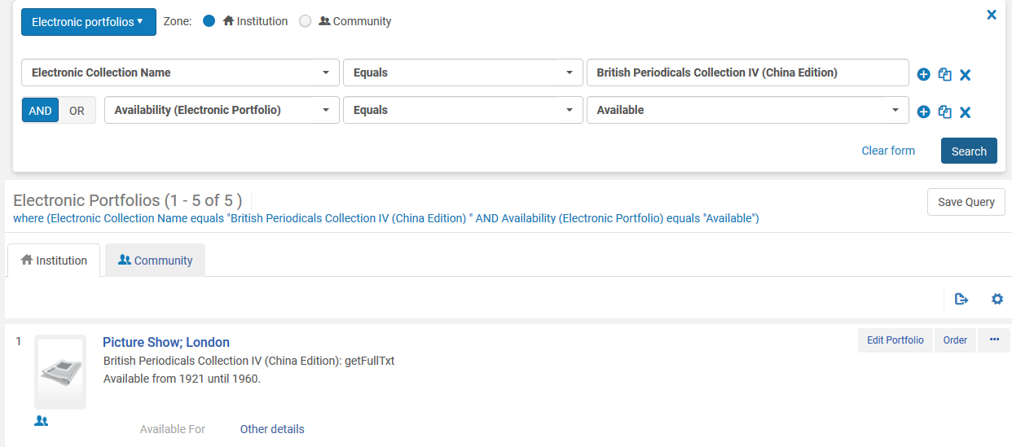
Fixing the Excel sheet so all portfolios will be activated
All five portfolios are now active in the institution

Slide 27
Yoel.Kortick@exlibrisgroup.com

